Slide 1
CASE STUDY
IOT AND ARTIFICIAL INTELLIGENCE INTEGRATION

Slide 2
AGENDA:
INTRODUCTION
ARTIFICIAL INTELLIGENCE
INTEGRATION OF IOT AND AI
REAL LIFE CASE STUDY
APPLICATIONS, CHALLENGES, AND FUTURE SCOPE
CONCLUSION

Slide 3
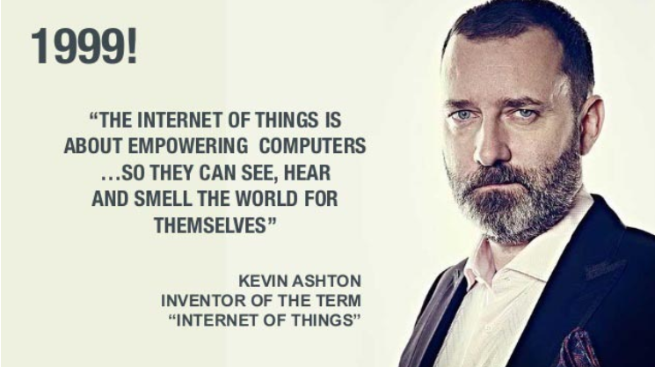
INTRODUCTION :
The Internet of Things (IoT) is a network of physical objects embedded with sensors, software, and connectivity technologies. It allows these devices to collect, exchange, and act on data autonomously via the internet, eliminating the need for constant human intervention to achieve unprecedented efficiency and automation

Slide 4
ABSTRACT :
The Internet of Things (IoT) connects physical devices to the internet, enabling them to collect and exchange data. Artificial Intelligence (AI) allows computers to analyse this data, learn patterns, and make intelligent decisions. The integration of IoT and AI, known as AIoT (Artificial Intelligence of Things), creates smart systems capable of automation, prediction, and real-time decision-making. AIoT is widely used in healthcare, agriculture, smart homes, industries, and transportation.

Slide 5
ARTIFICIAL INTELLIGENCE :
Artificial Intelligence is a branch of computer science that enables machines to perform tasks that normally require human intelligence.
AI Techniques
Machine Learning
Deep Learning
Computer Vision
Natural Language Processing

Slide 6
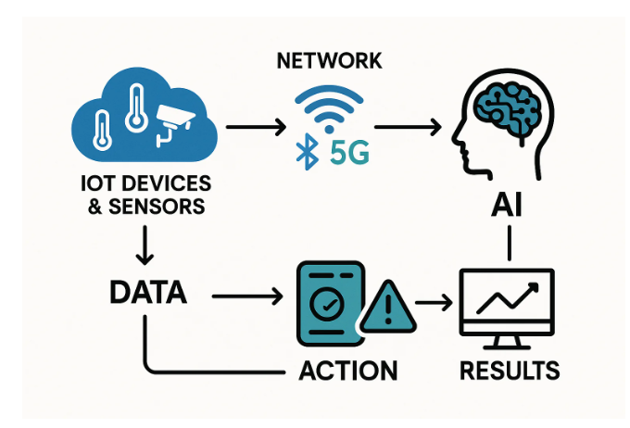
INTERGRATION OF IOT AND AI:
Working Principle
Sensors collect data.
IoT devices transmit data through the internet.
Cloud or edge computing stores the data.
AI algorithms analyze the collected information.
Intelligent decisions are made automatically.
Commands are sent back to devices.

Slide 7
REAL LIFE CASE STUDY :
Smart Agriculture using AIoT
Problem:
Farmers often waste water and fertilizers due to lack of continuous monitoring.
Solution:
An AI-enabled IoT system monitors:
Soil moisture
Temperature
Humidity
AI predicts irrigation needs and automatically switches water pumps ON or OFF.

Slide 8
APPICATIONS:
APPICATIONS:
CHALLENGES :
FUTURE SCOPE:
Smart Homes
Healthcare
Smart Cities
Manufacturing
Agriculture
Transportation
Energy Management
Data privacy
Cybersecurity threats
High implementation cost
Large data storage
Internet dependency
Device compatibility
Future AIoT systems will use:
5G communication
Edge AI
Autonomous vehicles
Smart hospitals
Intelligent factories
Sustainable smart cities

Slide 9
CONCLUSION:
The integration of Artificial Intelligence and the Internet of Things has transformed connected systems into intelligent systems capable of learning and making decisions automatically. AIoT improves efficiency, productivity, safety, and sustainability across many industries. As technologies like 5G and edge computing continue to evolve, AIoT will play a crucial role in developing smarter and more connected societies.

